Slide 1
Learning - From Examples

Slide 2
What Is Machine Learning
Tom Mitchell - Improving with experience at some task
Wikipedia - Machine learning is a scientific discipline that explores the construction and study of algorithms that can learn from data
Algorithms that can improve their performance using data

Slide 3

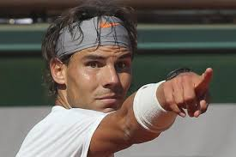
When should I play Tennis ????

Slide 4
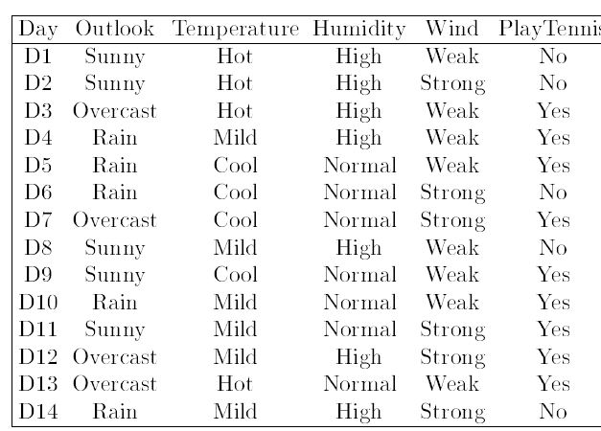
Classification

Slide 5
Classification

Slide 6
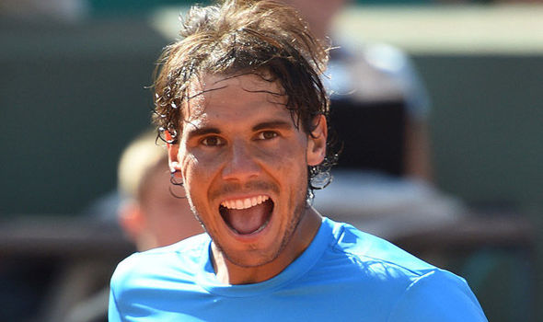
Classification
Seems Like I really enjoy it when the outlook is overcast!!!!!

Slide 7
Classification
What About When Its Sunny or Raining ????

Slide 8
Classification

Slide 9
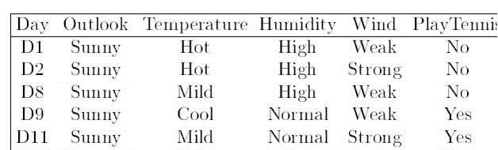
Classification

Slide 10
Classification
So, Its Humidity !!!!!!!!

Slide 11
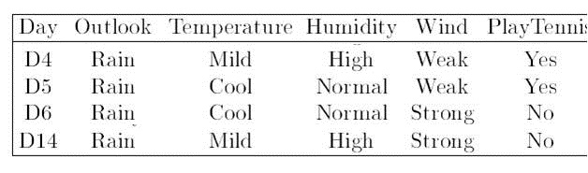

Slide 12
Its Wind !

Slide 13
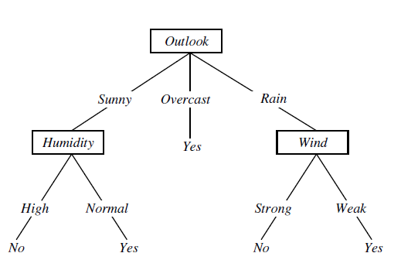
Learned Tree for Prediction

Slide 14

Thank you Awesome young A.I. Programmers!!!!!!

Slide 15
Feature Vector
Class Label

Slide 16
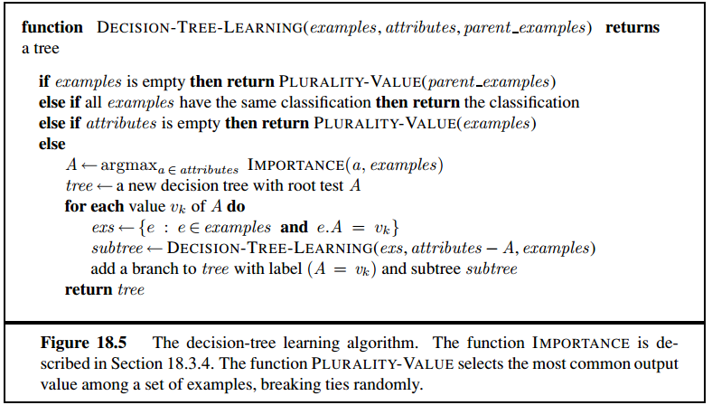

Slide 18
How to choose the Most Important attribute ???

Slide 19
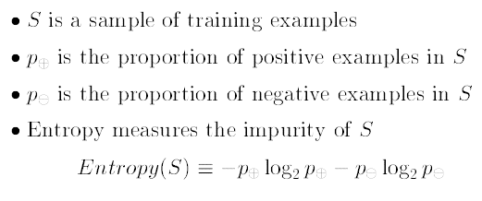
Entropy

Slide 20
Entropy
Entropy Is Zero (Minimum), When all the examples belong to same class!!!
Entropy Is 1(Maximum), When there are equal number of positive and negative examples!

Slide 21
Entropy
Entropy Is Zero (Minimum), When all the examples belong to same class!!!
Entropy Is 1(Maximum), When there are equal number of positive and negative examples!

Slide 22
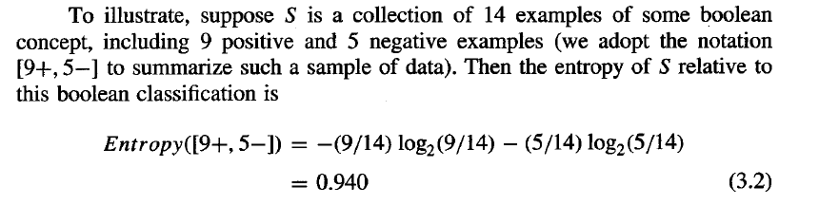


Slide 23

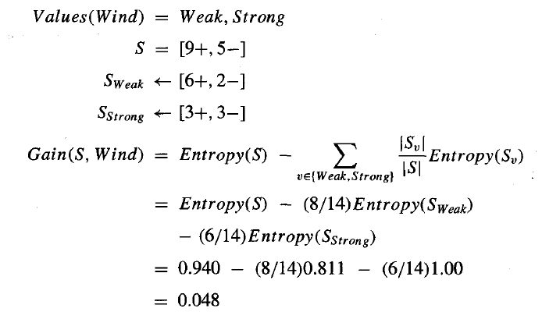
Information Gain

Slide 24
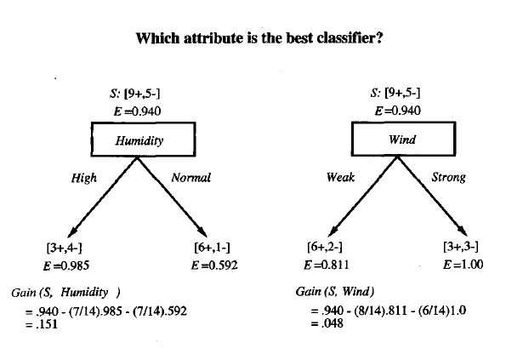

Slide 25
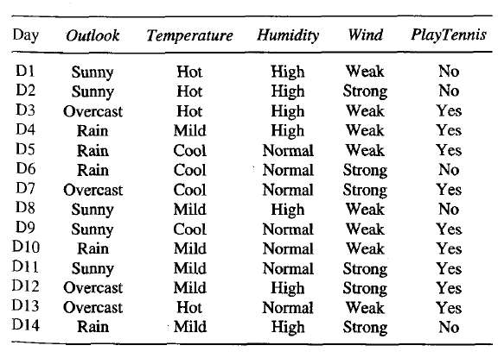
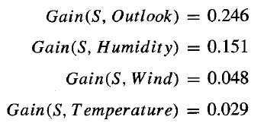

Slide 26
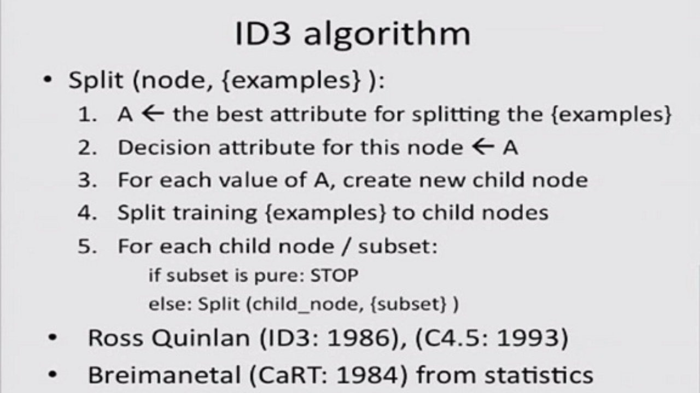

Slide 27

Why Reduce Entropy ???

Slide 28
How & Why am I preferring shorter trees ?

Slide 29
Does it take me to the global optimum ???

Slide 30
Why didn’t I just classify over the attribute “Day” ???

Slide 31
Learning From Examples
The problem we just saw is a “Classification” problem
Which is a member of a broader class
Supervised Learning
The approach we learned is a “decision tree classifier”
The algorithm name is ID3

Slide 32
Supervised Learning
Given a training set of N example input-output pairs (x1, y1),(x2, y2), . . .(xN, yN)
each yj was generated by an unknown function y = f(x)
x is a vector
Labeled dataset
Discover a function h that approximates the true function f.
The function h is called a hypothesis

Slide 33
Supervised Learning - Training Phase
Training Phase: The supervised learning algorithm first learn the model using the labeled example
Model
Supervised Learning Algorithm
Training Examples <x,y>

Slide 34
Supervised Learning - Test Phase
Use the model to predict the label of an unknown example
Learned Model
Label
Unknown Example

Slide 35
Let us consider a new problem!!!
Given 100s examples of house price with its floor space, learn from the data a model which can predict the price of a house, given the floor space as input
House Size in Square Feet | House Price in $
750 | 400,000
2500 | 720,000
1800 | 600,000
… | …
… | …
… | …
3500 | 900,000

Slide 36
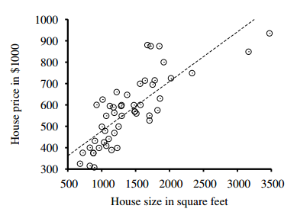
Let us consider a new problem!!!
Given 100s examples of house price with its floor space, learn from the data a model which can predict the price of a house, given the floor space as input

Slide 37
Have you seen any method/ tool that can solve this problem????

Slide 38
Univariate Linear Regression
We will now consider hypotheses, that are linear functions of continuous values
Lines in n-dimensional space

Slide 39
Univariate Linear Regression
For this particular problem we will “fit a straight line”
The learned model will be a straight line in a 2-D space

Slide 40
Univariate linear regression
A univariate linear function (a straight line) with input x and output y has the form y = w1x+ w0,
where w0 and w1 are real-valued coefficients to be learned.
The ws are called weights
The weight vector [w0, w1]
Remember the term “weight vector”, you will hear about this a lot

Slide 41

Hypothesis
The Hypothesis is parameterized by the weight vector “w”
We define the “loss function” as,
We want to find

Slide 42
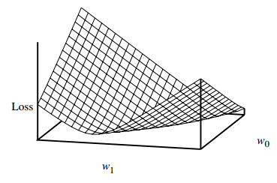
Weight Space
Here, the loss function is convex
implies that there are no local minima

Slide 43
Weight Space
every linear regression problem with an L2 loss function is convex
So, we can have closed forms
However, non-linear models may not have any closed form, and hence we need a generic approach

Slide 44
Greedy Local Search
As, the Loss Function is convex, there are no local minima
Greedy Local Searches can find global optimum point too

Slide 45
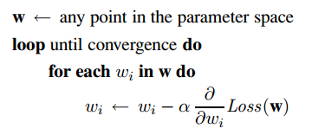
Gradient Descent
alpha is the learning rate

Slide 46
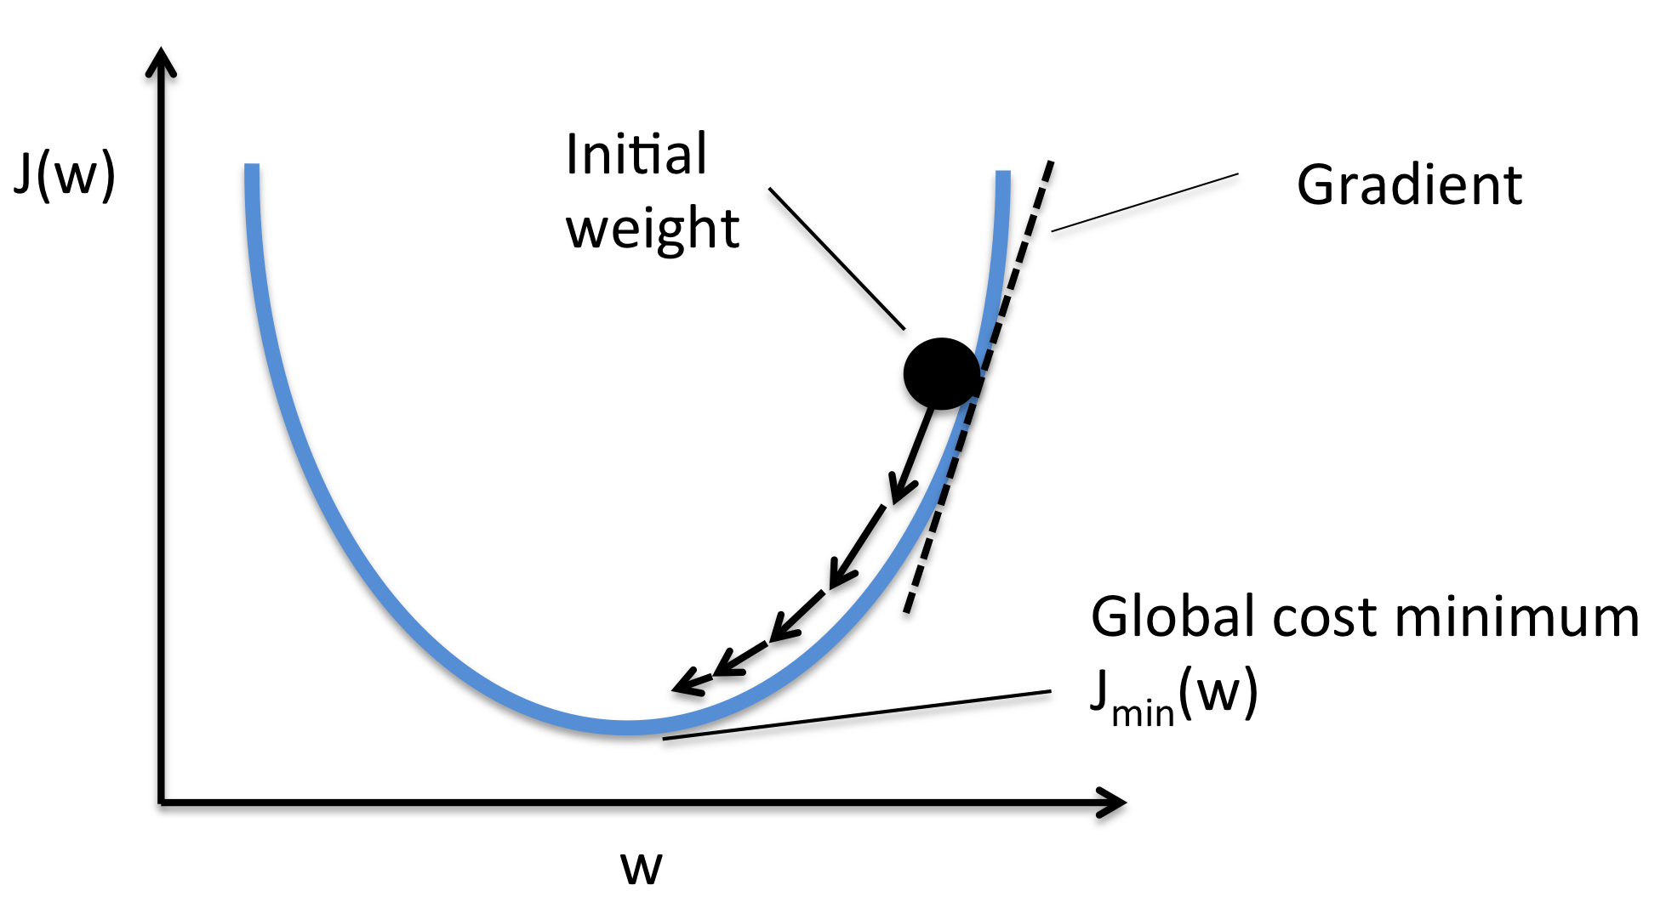
Gradient Descent

Slide 47
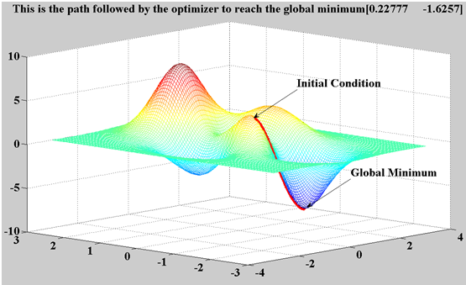
Gradient Descent

Slide 48
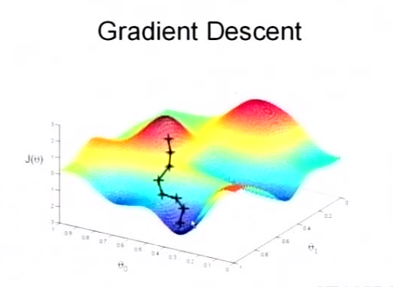
Gradient Descent

Slide 49
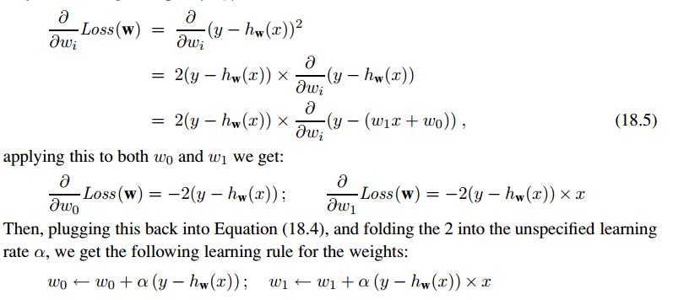
Calculating the derivatives
Simplifying for only one training example

Slide 50
Interpretation of the Gradient Descent Algorithm
Consider the cases
The prediction is lower: hw(x) < y
The prediction is higher: hw(x) > y
The prediction is equal: hw(x) = y
How does the weight changes to fit the model ??

Slide 51
Batch Gradient Descent
For N training examples, we want to minimize the sum of the individual losses for each example
Convergence to the unique global minimum is guaranteed (as long as we pick α small enough)
May be very slow: we have to cycle through all the training data for every step, and there may be many steps
What happens if α is large???

Slide 52
Stochastic Gradient Descent
Consider only a single training point at a time
Cycle through the same training data as many times as is necessary, taking a step after considering each single example
“Often” faster than batch gradient descent.

Slide 53
Stochastic Gradient Descent
With a fixed learning rate α, however, it does not guarantee convergence;
it can oscillate around the minimum without settling down. In some cases, as we see later,
A schedule of decreasing learning rates (as in simulated annealing) can guarantee convergence.

Slide 54
Stochastic Gradient Descent
Can also be used in an “online” setting
where new data are coming in one at a time
And we need to update the model as new data arrives

Slide 55


Multivariate LR
Introduce a dummy input attribute, xj,0, which is defined as always equal to 1
Dot product of weight vector and input vector
Can also utilize matrix operations

Slide 56


Multivariate LR

Slide 57
Generalization
A hypothesis generalizes well if it predicts the value of y for novel examples with high accuracy

Slide 58
Consistent Hypothesis
A hypothesis is consistent if it agrees with all the data

Slide 59
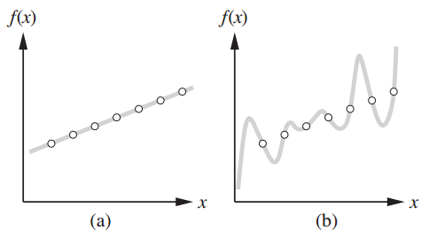
Both Model fit the data
Which model should we select?

Slide 60
Ockham’s Razor
prefer the simplest hypothesis consistent with the data

Slide 61
Simpler Models Generalize Well

Slide 62
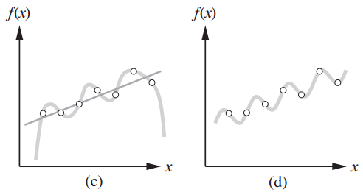
Simpler Models Generalize Well

Slide 63
Expressiveness of Hypothesis Space vs. Learning Complexity
A more expressive hypothesis may require a heavier computation
Simple Models
Can be learned with less heavy computation
Can compute y fast

Slide 64
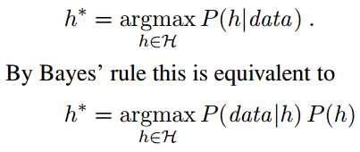
Probabilistic Look into Supervised Learning

Slide 65
Evaluating Hypothesis
We desire a hypothesis that fits the future unseen data best
How to know which hypothesis among many is better ?
How to measure the goodness of a hypothesis?

Slide 66
Stationarity Assumption
Stationarity Assumption: There is a probability distribution over examples that remains stationary over time.
Each example data point (before we see it) is a random variable Ej, whose observed value ej = (xj, yj) is sampled from that distribution

Slide 67


I.I.D
Each data is independent of the previous examples
Each example has an identical prior probability distribution:
Examples that satisfy these assumptions are called independent and identically distributed

Slide 68
Error Rate
error rate of a hypothesis is the proportion of mistakes it makes
the proportion of times that h(x) is not equal to y for an (x, y) example

Slide 69
Error Rate and Goodness of learner
Error rate can indicate “goodness” of a learner
However, error rate on training set does not guarantee a “generalized” model
Its like securing A+ by cramming the “leaked exam questions” just before exam

Slide 70
Holdout Cross-Validation
Randomly split the available data into a training set and test set
Training: Use training set to learn the hypothesis h
Evaluation: Use the test set on to measure the accuracy of h

Slide 71
Holdout Cross-Validation
Disadvantages:
if we use half the data for the test set, then we are only training on half the data, and we may get a poor hypothesis.
On the other hand, if we reserve only 10% of the data for the test set, then we may, by statistical chance, get a poor estimate of the actual accuracy.

Slide 72
k-fold cross-validation
First split the data into k equal subsets.
We then perform k rounds of learning
On each round 1/k of the data is held out as a test set and the remaining examples are used as training data.
A better estimate than a single score.
The extreme is k = n, also known as leave-one-out cross-validation or LOOCV

Slide 73
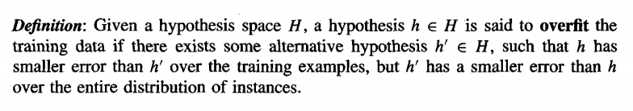
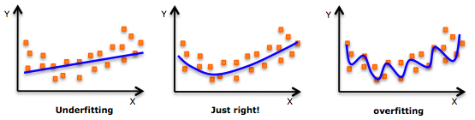
Overfitting

Slide 74
Noise & Overfitting
random noise in the training examples can lead to overfitting
A noisy example in this partition would have let the tree grow further

Slide 75
Coincidental Regularities & Overfitting
The observations can show a pattern, which in fact are just coincidental
The pattern may not be seen if more data is collected
Coincidental Regularities can cause overfitting

Slide 76
Learning
There are three main types of learning
Supervised Learning
Unsupervised Learning
Semi-Supervised Learning

Slide 77
Supervised Learning
the agent observes some example input output pairs and learns a function that maps from input to output
Two basic types
Classification
Regression

Slide 78
Supervised Learning
Labeled Examples
Given input-output pairs as example
Learns a function/hypothesis that maps input to output
Can be thought as there is a teacher/oracle who gives you “labeled examples”

Slide 79
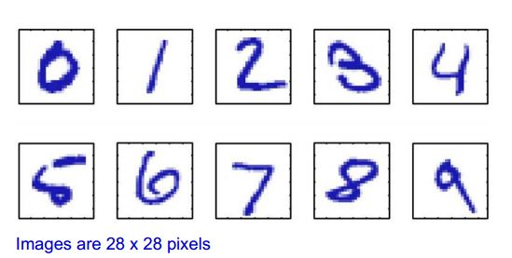
Example – Character Recognition(Classification)
Lets say we have 1000 worked-out examples
We can then train an algorithm with these examples, which can then recognize unseen examples

Slide 80
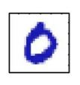

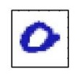

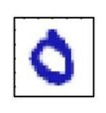

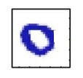
Training Examples
Image | Classification
 | Zero
 | Three
 | Five
 | Nine
Image | Classification
 | Zero
 | Zero
 | Zero
 | Zero

Slide 81
Function Approximation/Regression
We have information about Tamim Iqbal’s last 100 One Day innings
What will be Tamim Iqbal’s score if??
Weather – Mild, Pitch – Flat, Venue-Dhaka D/N- No
Weather | Venue | Pitch | Day/Night | … | Run
Cold | Mirpur | Flat | Yes | … | 15
Mild | Auckland | Green | Yes | … | 11
Sunny | Lords | Dusty | No | … | 83
… | … | … | … | … | …
Cold | Mirpur | Flat | No | … | 10

Slide 82
Unsupervised Learning
the agent learns patterns in the input even though no explicit feedback is supplied
The most common unsupervised learning task is clustering

Slide 83
Clustering
Find group of similar points
Help marketers discover distinct groups in their customer bases, and then use this knowledge to develop targeted marketing programs
Each customer may be represented by their salary, amount of products bought per month, living place, education, qualification, number of credit cards used, etc.

Slide 84
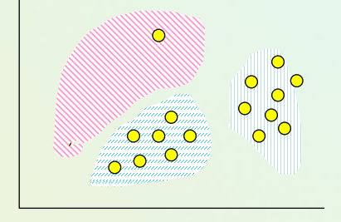
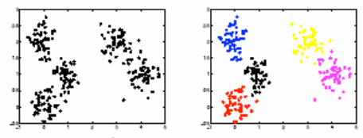
Clustering

Slide 85
Reinforcement Learning
the agent learns from a series of reinforcements
rewards or punishments

Slide 86
What is the difference between reinforcement learning and supervised learning ????

Slide 87
Three Main Types of Learning
The three main types arise based on the type of feedback that the agent gets from the environment

Slide 88
The importance of feature vector in case of supervised learning
The features should actually have effect on the classification

Slide 89
Important Concepts to learn
Feature Vector and feature space
Over Fitting
Generalization
Training, Test, and Validation Data
Noise in training data
Hypothesis, Hypothesis Space
Weight Vector, Weight Space
Etc..

Slide 90
Reinforcement Learning Demos
https://www.youtube.com/watch?v=xM62SpKAZHU
https://www.youtube.com/watch?v=NV9xViSfoBA

Slide 91
☺

